Slide 1
Y11’s trip to Italy: extracting essential oils and testing their effectiveness
Galileo Galilei school, Jesi.

Slide 2
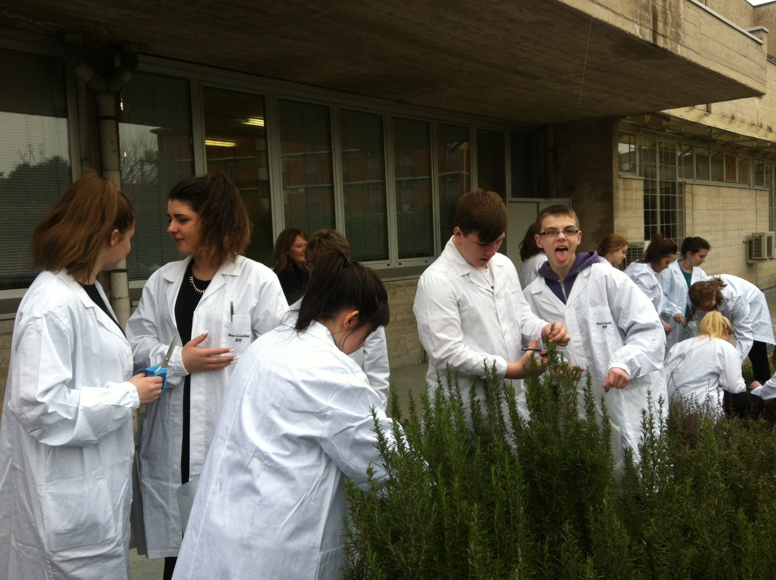
Step 1 Collecting the plants
1 – We went outside to pick the plants and removed their leaves.

Slide 3
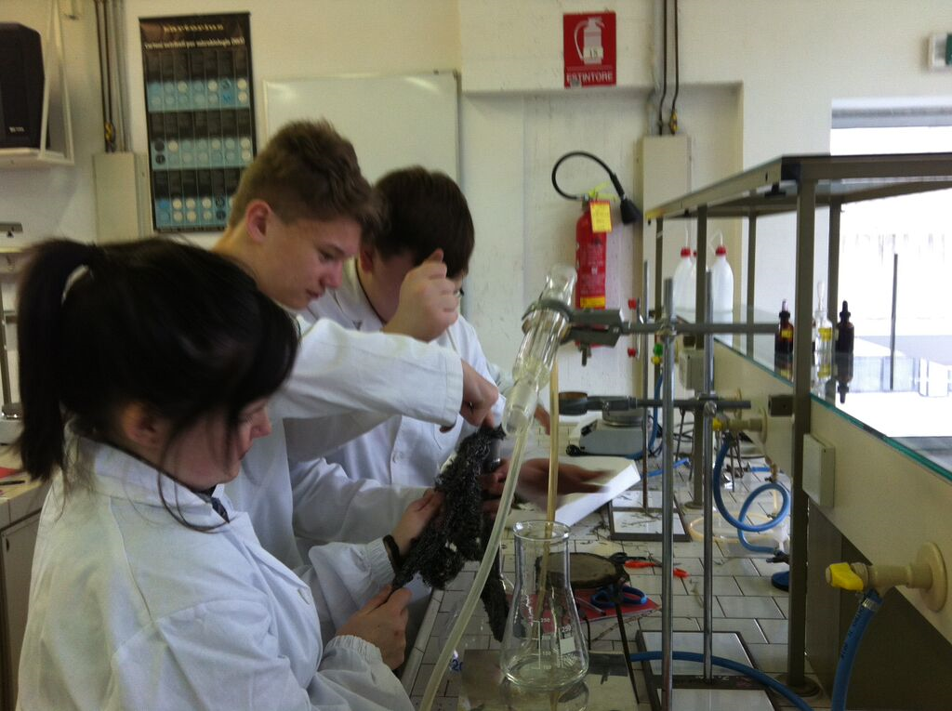
Step 2 Extracting the Oils
1 – Set up equipment
2 – Tear plant leaves and put them into the round bottomed flask
3 – Turn the Bunsen burner onto a roaring flame
4 – Turn the water on and allow water to flow into the distilling tube
5 – Leave the Bunsen to burn
and heat the plant oil
6 – Collect the plant oils in a
beaker at the end of the
distilling column

Slide 4
Step 3 Testing effectiveness of oils
1 – We made our own agar – being sure not to allow any contamination (shown on next slide)
2 – We smeared the bacteria across the agar jelly and placed disks containing the essential oils onto the agar.
3 – We sealed the petri dish, ensuring no contamination reached the agar
4 – We left the agar jelly and plant oil in an incubator and allowed bacteria to grow
5 – We compared the different plant oils by seeing which disk had the least bacterial growth around it

Slide 5
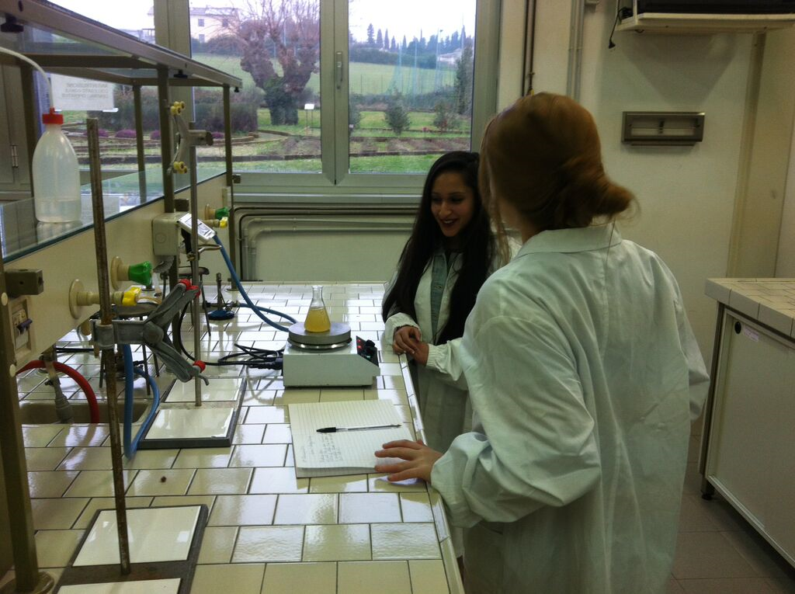
Making agar

Slide 6
Growing bacteria

Slide 7
Results
The plant extracts zone of inhibition was greater than the zone of inhibition of the antiseptic, with the exception of eucalyptus. Therefore, plant extracts are better for treating bacterial infections caused by s.aureus than the antiseptic.

