Slide 1
Take A Chance
Notes:
Resources: 6 cards with awards on the back, ranging from jump the dinner queue, bag of sweets, pen, to a detention. Make them different colours.
I need a member of each form. You can pick one card, unfortunately the choice gets less.
Share the prize on the back.
Explain that sometimes we have to choose something and the only thing we can go off is first glance. This was possibly favourite colour.
Do you decide on whether you will try something by the way they look or sound.

Slide 2

Doors of opportunity
Notes:
Explain that most of the doors we pass through are familiar to us. We know what to expect when we go through our classroom door or the front door of our home or our bedroom door. However, in our lives there are other doors that we all experience. These are often called ‘doors of opportunity’.

Slide 3
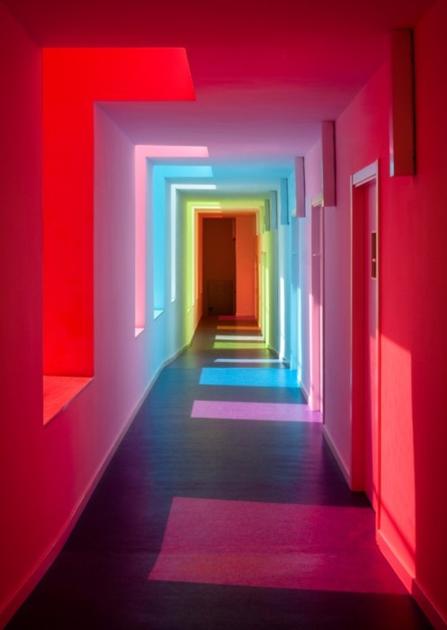
Notes:
Sometimes you have chances in sport. How many of you take the opportunity to partake in a sport outside school and commit to training and matches. One of our youngsters is a GB BMX rider and another a GB diver. Both have to give up a lot of free time to reach the level required to compete for the country.

Slide 4
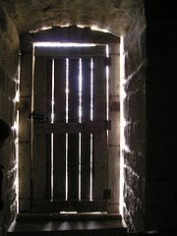
Notes:
How many of you look at the meal your mum has cooked and turn your nose up by the way it looks?
Two of our girls travelled to Italy and lived with Italian families for almost two weeks. Whilst there they tried a number of different meals, including snails. Would you have been brave enough?

Slide 5

Notes:
School has 5 lessons a day, do you take the opportunity to learn anything else?
Did you know that art, computing, French and statistics are being taken by youngsters in year 10 and 11 which is outside their normal timetable as an extra GCSE.
Some of our year 11 took the opportunity to learn some basic Italian for the visit to Ancona, to ensure they could speak a little to their new friends.

Slide 6
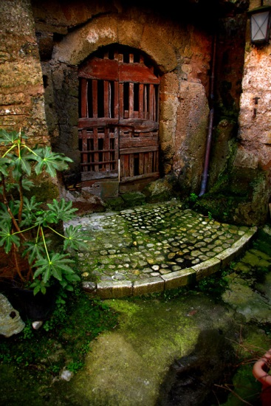
Notes:
Do you take the opportunity to lead and manage events? One of our youngsters has helped organise and run the Year 7 residential break. Using their organisation skills they planned activities and helped set up the camp itself.
Members of the Italian trip in year 11 have written a powerpoint for the year 10 science lessons. It is to be used by the science teachers in supporting the teaching of a crucial topic. That piece of work will be there for ever now!

Slide 7
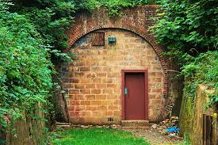
Notes:
Have you ever done something you’ve never done before?
Some of the girls on the Italian trip had never been abroad before, never been on a plane and didn’t own a passport. This trip taught them how to navigate an airport and all its security but also showed them how to handle a joining flight, as it was not direct. The group supported each other!

Slide 8
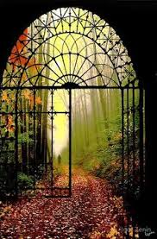
Notes:
Have you ever done something you’ve been scared about?
One of the teachers had the chance to visit the Italian school, but had to go alone. Not only had they have to overcome the fear of not sharing the experience with someone else, but also the language barrier that was present. They are allergic to cheese, so having to explain to someone who doesn’t necessary understand English was quite worrying.

Slide 9
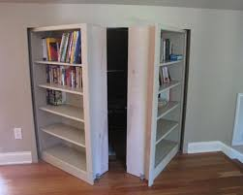
Notes:
Have you ever realised that when you venture into other places or events, you notice similarities and differences, that you would not have noticed if you’d have stayed ‘safe’?
For instance, if the visit to Italy hadn’t have happened, the knowledge that their science curriculum is similar to ours would have been lost. The fact that their school day is 8 til 1, and lunch is at home would have never been shared.
Go through the doors and see the other side. You can always come back.

Slide 10
Doors of opportunity
Notes:
Each new opportunity we are given is like a door. We can choose to keep the door shut and not walk forward and pass through it – we can choose not to take the opportunity given to us. Or we can say ‘yes’ to the opportunity. To say ‘yes’ is like opening a door and walking through it to experience whatever the new opportunity has to offer.
Sometimes what we find on the other side may be difficult and we may decide that we don’t like it, but at least we have had a new experience to take with us into the rest of our lives.
You probably felt a bit worried. Trying new things takes courage – you have to be brave enough to step forward and have a go even though you aren’t certain what will happen
At the sixth form college last week, the assistant principle proudly told us of their best students; however one thing he said stuck in my mind. He said ‘Busy students are the best students’. The ones who have a go at lots of things, give up their time to help others and manage their lives so as to fit everything in, happen to gain the best results and best opportunities. Its not just because they manage their time well and complete many tasks, but its because they’ve made themselves stand out. They’ve made their job application or personal college/ university statement interesting and different from others. They are not the norm; they are special. Everyone is unique and different but we study the same subjects at school and some of you will gain the same grades, so when you go out into the work place or college, how are you going to make yourself unique and different again? Which doors of opportunity will you walk through so you stand out!

